Slide 1

Alpine in your Browser: The Open OnDemand Gateway

Slide 2
Alpine in your Browser! The Open OnDemand Gateway
Instructors: Trevor Hall, Brandon Reyes
Website: www.rc.colorado.edu
Helpdesk: rc-help@colorado.edu
Slides: https://github.com/ResearchComputing/OpenOnDemand
Survey: http://tinyurl.com/curc-survey18

Slide 3

RMACC Cyber Infrastructure Portal
https://ask.cyberinfrastructure.org/c/rmacc/65
This forum provides an opportunity for RMACC members to converse amongst themselves and with the larger global research computing community.
The “go to” general Q&A platform for the global research computing community - researchers, facilitators, research software engineers, CI engineers, sys admins and others.
Notes:
Stack exchange but for RC specifically

Slide 4
Agenda
About Open OnDemand
What is ACCESS-CI?
How to log in to Open OnDemand
Features of Open OnDemand
Using the Shell
File Transfer
Job Monitoring and Composer
Interactive Applications
Demos!

Slide 5

Open OnDemand
Open OnDemand is an NSF-funded open-source HPC portal based on the Ohio Supercomputing Center's original OnDemand portal
Enables web access to HPC resources, including:
Easy file management
Command-line shell access
Job management and monitoring across different batch servers and resource managers
Graphical desktop environments and desktop applications

Slide 6
Open OnDemand (at CURC)
Open OnDemand provides a browser-based interface to interact with Alpine and Blanca!
All CURC users can access Open OnDemand
CU Users: https://ondemand.rc.colorado.edu/
CSU, AMC, RMACC users: https://ondemand-rmacc.rc.colorado.edu
Notable Features:
SSH-free terminal access
Remote desktop
Jupyter Notebooks
RStudio
MATLAB
Notes:
Only way for non-AMC RMACC members to access CURC

Slide 7

ACCESS-CI (RMACC Users Only)
ACCESS-CI provides:
Allocations
Support
Operations
Metrics
Supports CURC by managing RMACC users
Get an ACCESS-CI Account: https://identity.access-ci.org/new-user.html

Slide 8
ACCESS-CI (RMACC Users Only)
Once you have an ACCESS-CI Account, reach out to us with the following information:
Your ACCESS-CI username
Your institutional affiliation
Your role
Your department
Your first and last name
Your preferred email address
We will provision you an account!

Slide 9
Logging in to Open OnDemand

Slide 10
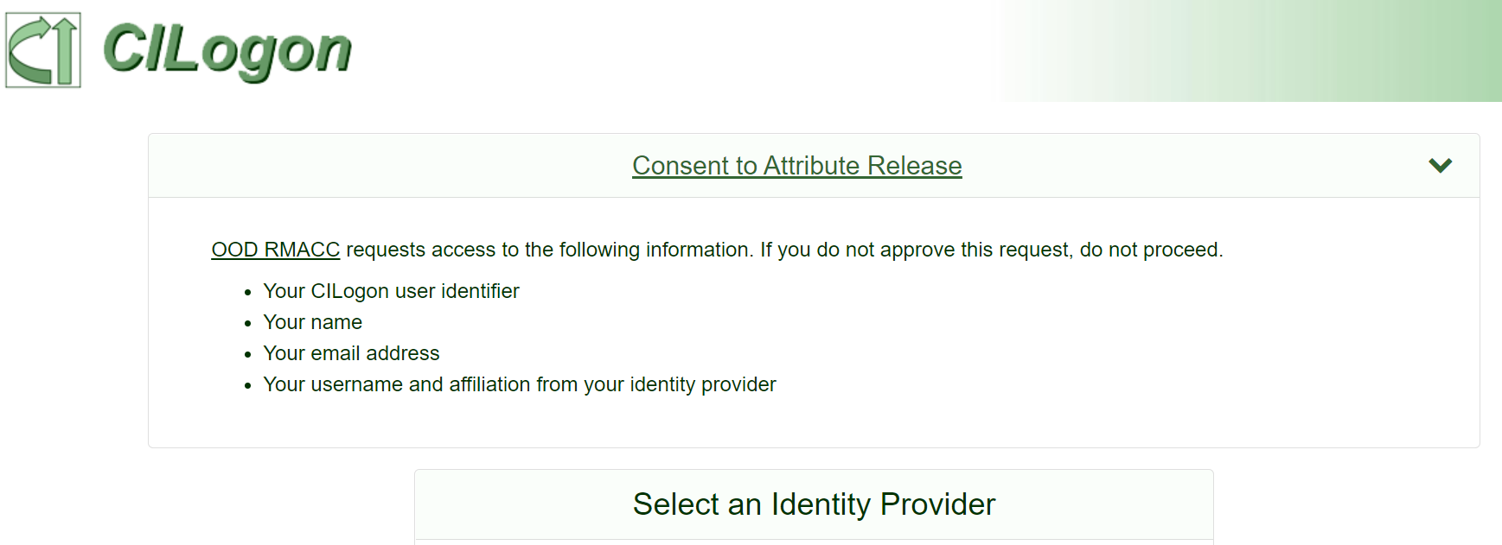
Logging In
CU Boulder: https://ondemand.rc.colorado.edu/
RMACC: https://ondemand-rmacc.rc.colorado.edu
You will be re-directed to the CILogon sign-in page:

Slide 11
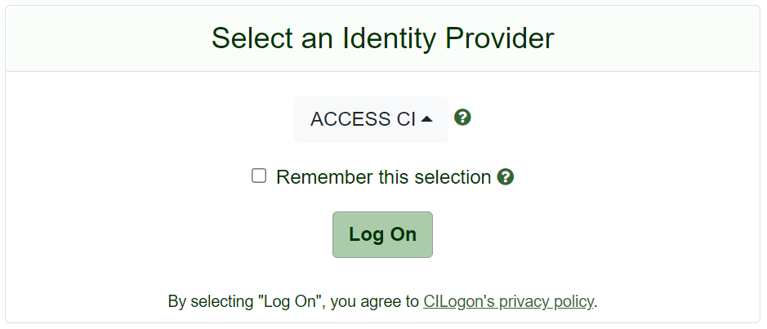
Logging In (RMACC Users Only)
Select your identity provider.
If you are a CSU user, select ‘Colorado State University’
If you are from any other institution, select ‘ACCESS CI (XSEDE)’

Slide 12
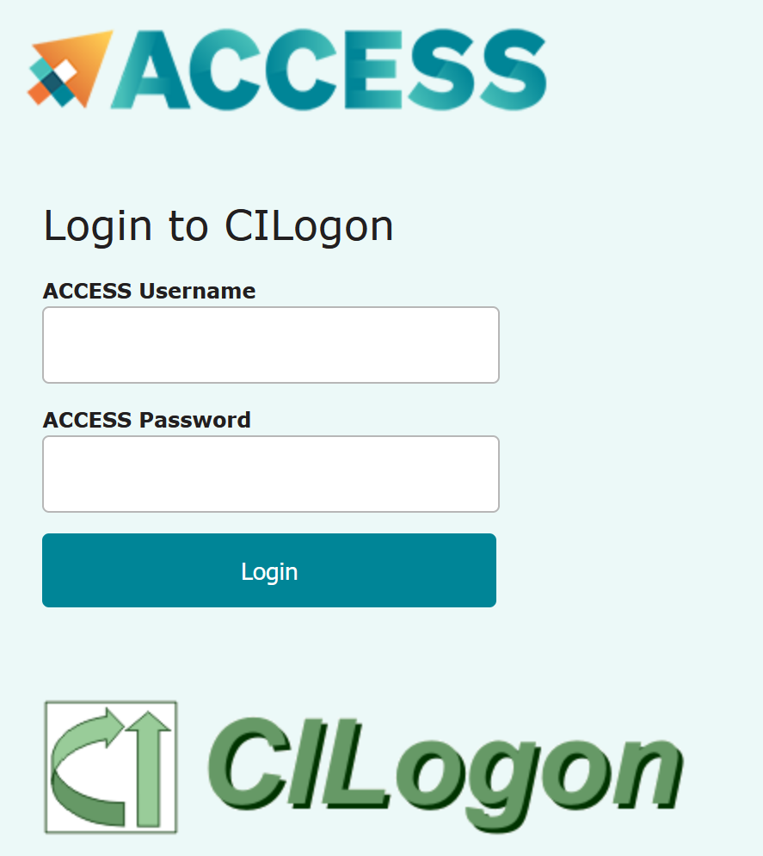
Logging In (cont.)
CU Boulder: Authenticate with your Identikey and Password
CSU: Authenticate with your EID and Password
RMACC: You will be redirected to the ACCESS-CI login page
Use your ACCESS username and password

Slide 13
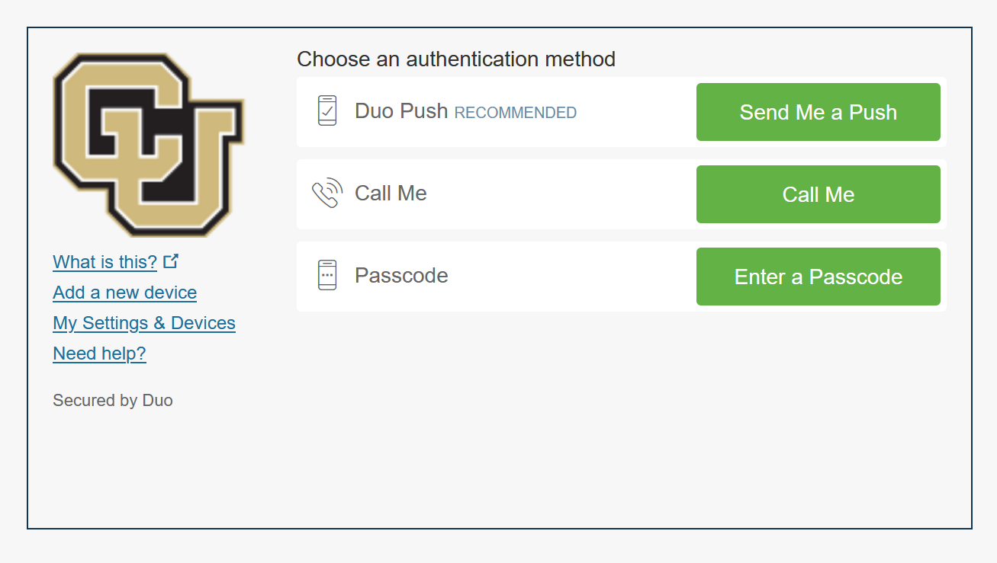
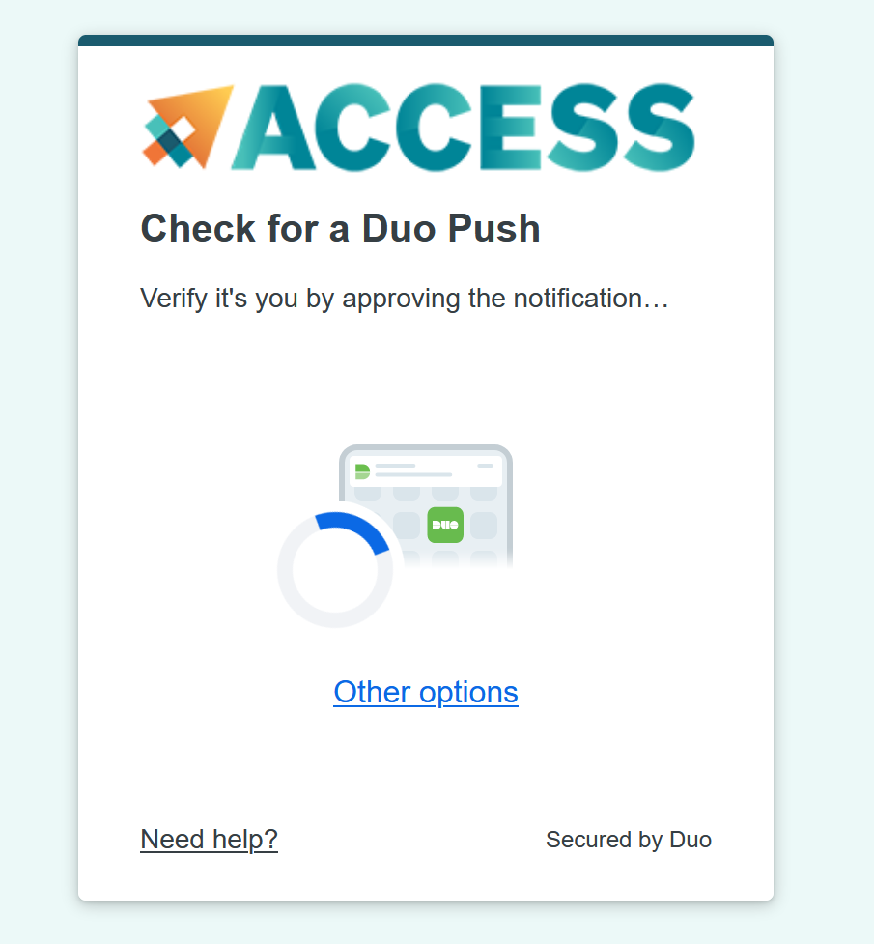
Logging In
Duo 2-Factor Authentication is a requirement for the security of our systems.
CU Boulder and CSU users must have this configured prior to logging in
RMACC users will be prompted to set up Duo 2FA upon logging in for the first time

Slide 14
Demo: Logging in to Open OnDemand
https://ondemand.rc.colorado.edu/
https://ondemand-rmacc.rc.colorado.edu

Slide 15
Features of Open OnDemand

Slide 16
OnDemand Home Page
From the home page, you can access the following Open OnDemand Features:
Files
Jobs
Clusters
Interactive Apps
My Interactive Sessions

Slide 17
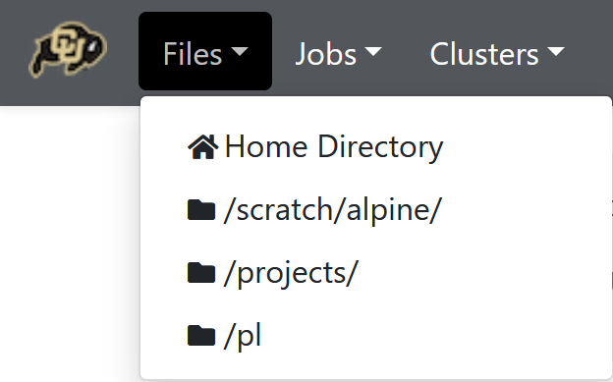
Files
Open OnDemand allows you to navigate and manipulate your files
You can access your entire CURC filesystem using this tool:
/home
/projects
/scratch/alpine
/pl (if applicable)

Slide 18
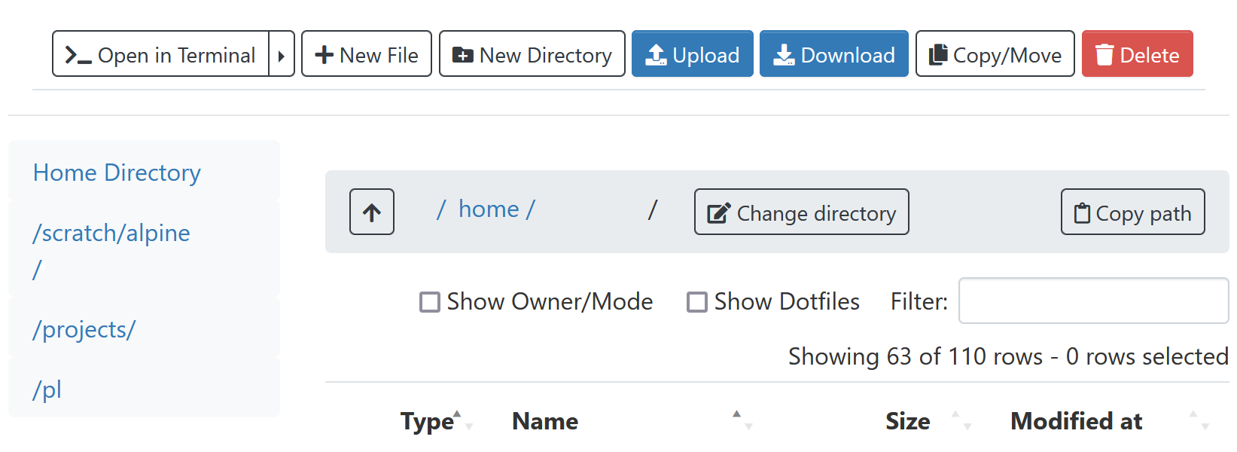
Files Management
On the files page you can:
Upload data
Download files
Create new files
Edit files
Copy/move data
Delete files
Create directories
Notes:
Note that this method of data transfer has a maximum file size of 10GB

Slide 19
Demo: File Transfer

Slide 20
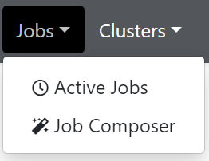
Jobs
Open OnDemand allows you to monitor jobs running on the system
You can monitor your own jobs, but you can also monitor all queued and running jobs
You can also create and submit jobs using the Job Composer tool

Slide 21
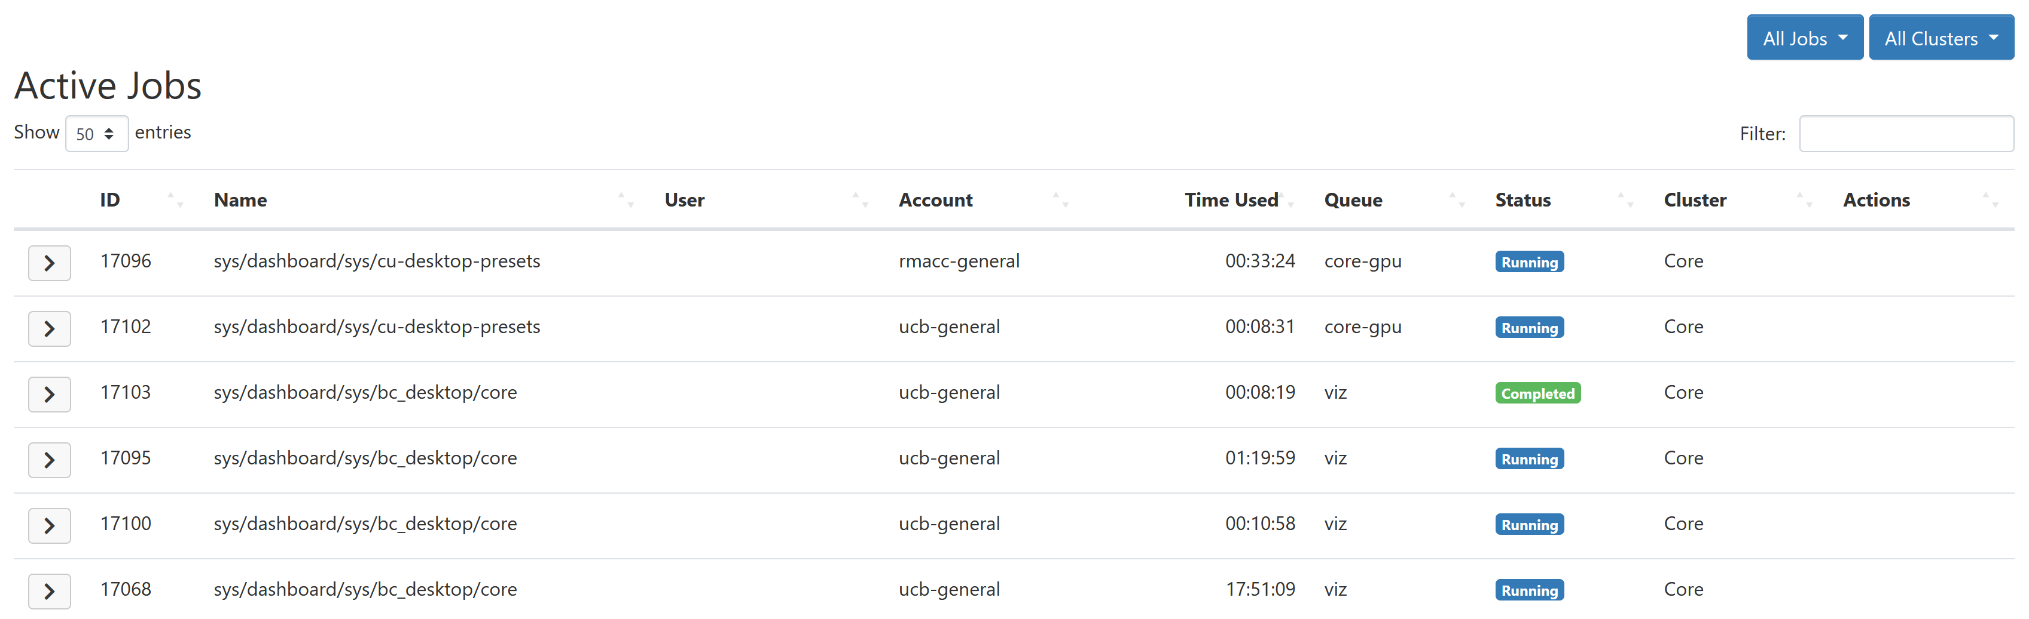
Active Jobs

Slide 22
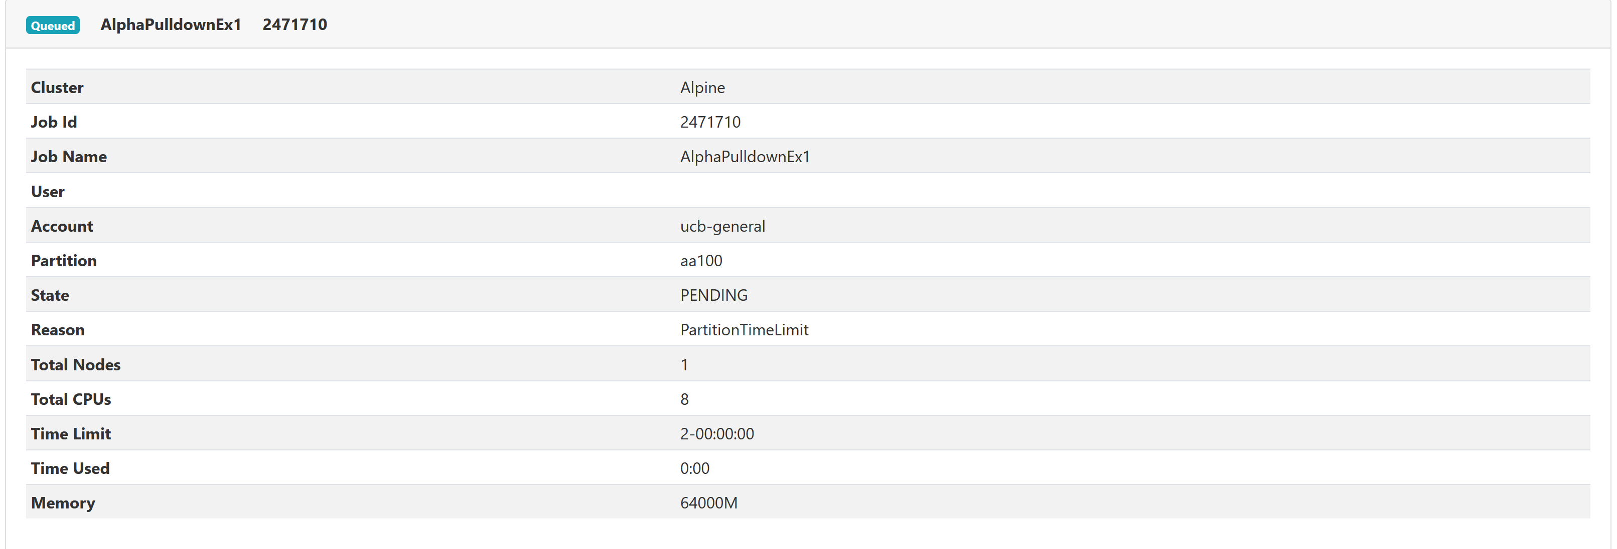
Active Jobs (cont.)
Here you'll see a list of jobs on the selected cluster(s)
If you select one of them, you can see details about the job

Slide 23
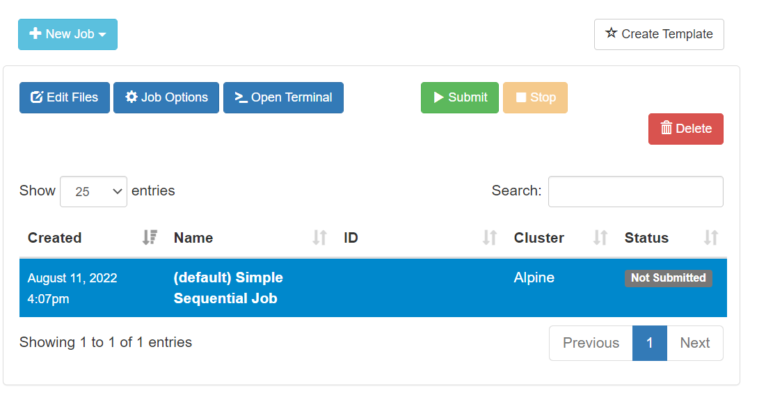
Job Composer
With the Job Composer, you can create a script and submit to the scheduler
Default templates are available, but you can use your own templates or edit using the built-in editor

Slide 24
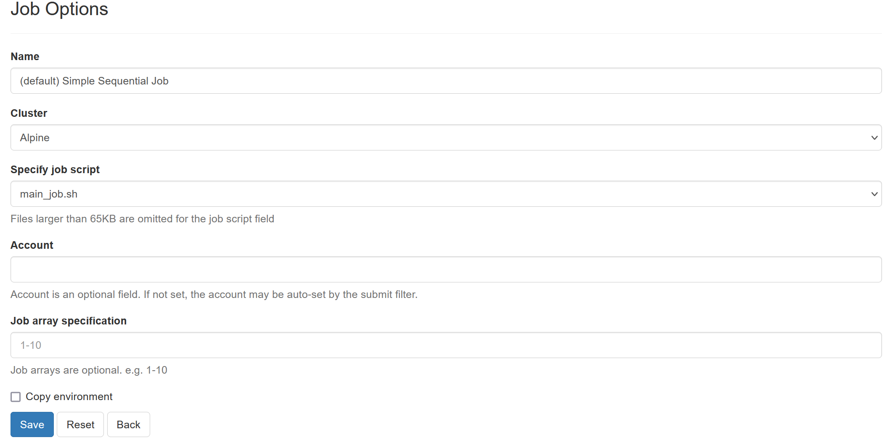
Job Composer Options

Slide 25
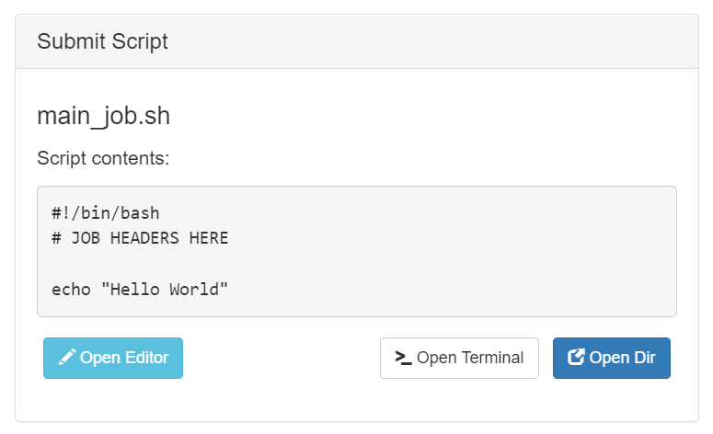
Job Composer Script
Once you've added all of the options for your job, you can view the script template
You can edit this file using OnDemand’s built-in text editor

Slide 26
Demo: Using the Job Composer

Slide 27
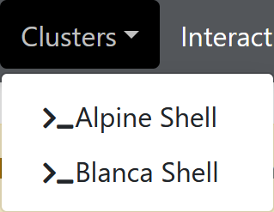
Clusters
Open OnDemand allows you to open a terminal in your browser, no SSH required

Slide 28
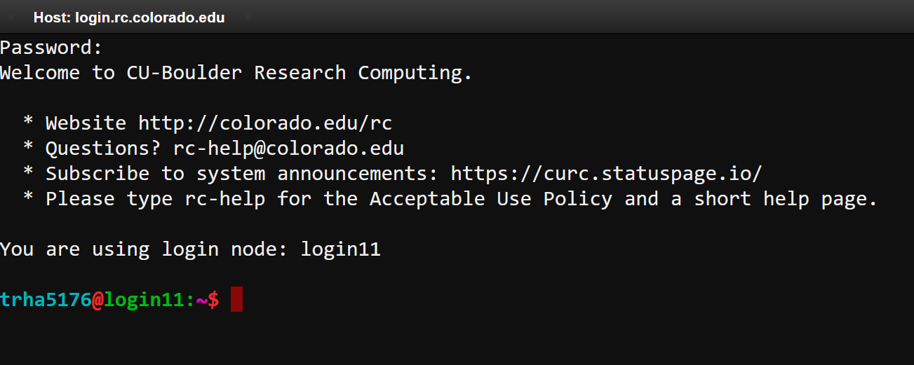
Terminal

Slide 29
Interactive Applications
https://curc.readthedocs.io/en/latest/gateways/OnDemand.html

Slide 30
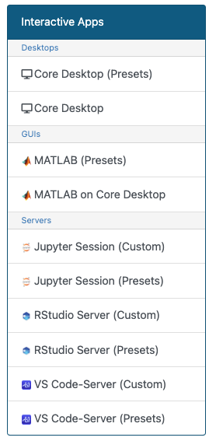
Interactive Apps
Interactive apps are comprised of built-in Graphical User Interfaces (GUIs) for many of the most popular research applications
Current Offerings Include:
Jupyter Notebooks
Remote desktop (Core Desktop)
RStudio
MATLAB
VS Code-Server
…with more coming soon!

Slide 31
Interactive Apps (cont.)
Each app comes with two spawning options:
‘Custom’ allows you to spawn a session with customizable configurations
If your configurations are incompatible, your job will not run!
‘Presets’ allows you to spawn a session with common, functional configurations
Works ‘out of the box’

Slide 32
Custom Application Inputs
Input | Description
Cluster | Possible options are Alpine and Blanca
Account | The account you would like to use: Standard CU Boulder value → “ucb-general” Standard CSU value → “csu-general” Standard RMACC value → “rmacc-general” Standard AMC value → “amc-general” Can use project allocations e.g. “ucbXXX_asc1”
Partition | Specifies a particular node type to use e.g. “ahub”
Number of cores | The number of physical CPU cores for the job
Memory [GB] | The total amount of memory allocated for the Job
QoS Name | Quality of Service (QoS) constrains or modifies certain job characteristics
Time | The duration of the job, in hours

Slide 33
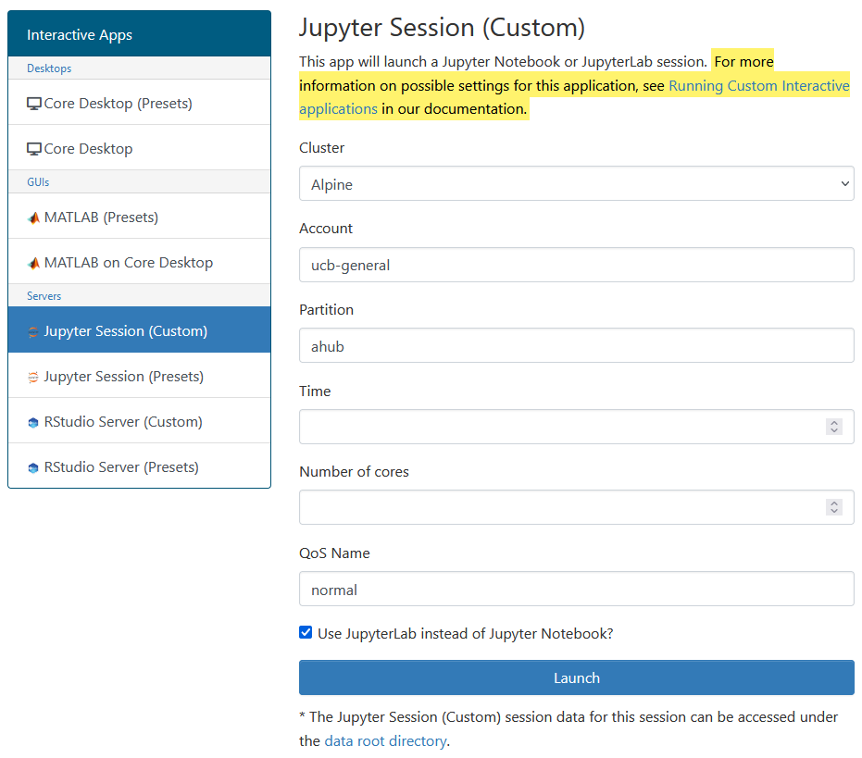
Jupyter Sessions
You can spawn a Jupyter Notebook using JupyterLab or Jupyter Notebook
If you want to use a custom environment, you must create a Jupyter Kernel
https://curc.readthedocs.io/en/latest/gateways/jupyterhub.html?#creating-your-own-custom-jupyter-kernel
Easiest to do with a conda environment
One can access a single Alpine GPU via the “Custom” application

Slide 34
Demo: Jupyter Session

Slide 35
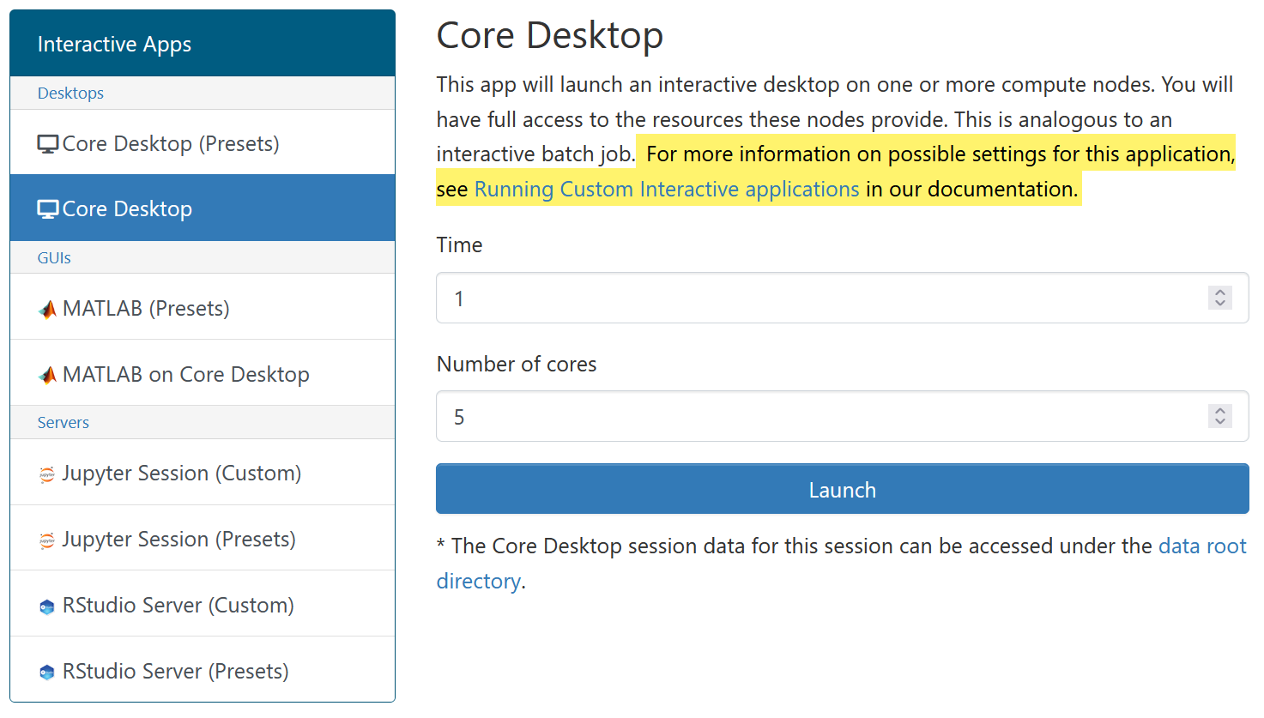
Core Desktop
A remote desktop i.e. an interactive desktop
Ran on their own compute nodes (not Alpine or Blanca)
All jobs are launched on shared GPUs
Not meant for serious GPU workflows!
Very useful for running GUI based software

Slide 36
Demo: Core Desktop

Slide 37
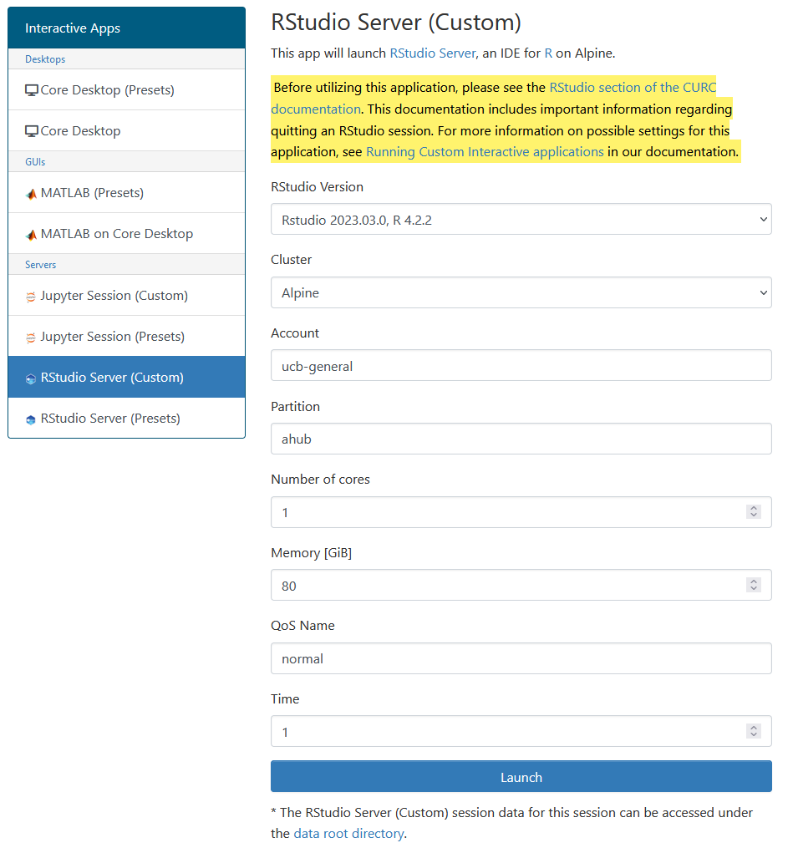
RStudio Server
Allows you to use RStudio, an Integrated Development Environment (IDE) for R
Currently in a Beta phase
Quirks may pop up
Ran inside an Apptainer container
Most R libraries are easily installable, but some may fail
We can help, just reach out to us!

Slide 38
Demo: RStudio

Slide 39
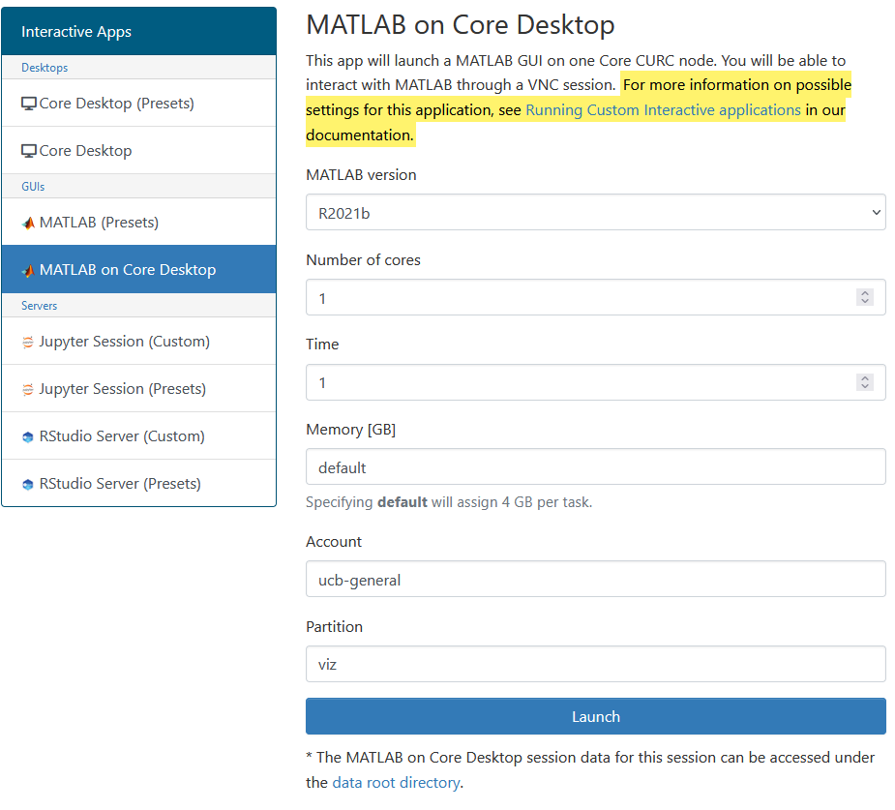
MATLAB
Launches a MATLAB GUI using Core Desktop
Same setup as Core Desktop
Not meant for serious workflows!
Several MATLAB versions are available
Using the default R2021b can improve load times (locally installed)

Slide 40
Demo: MATLAB

Slide 41
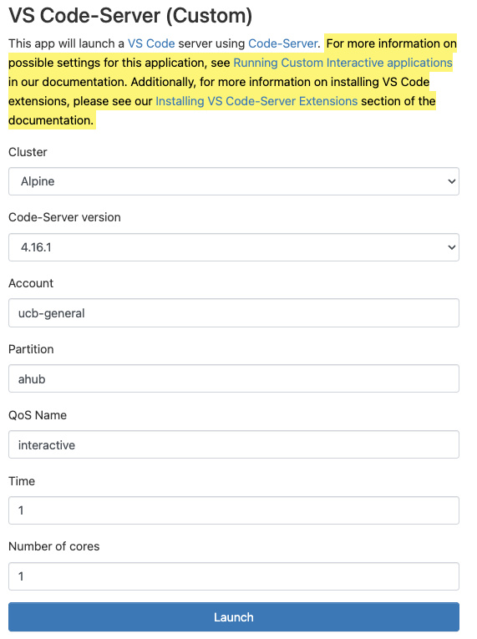
VS Code-Server
Launches Visual Studio (VS) Code in your browser
Uses the software Code-Server
Contains a majority of standard VS Code functionality
Downloading extensions may have to be done differently
https://curc.readthedocs.io/en/latest/gateways/OnDemand.html#installing-vs-code-server-extensions

Slide 42
Demo: VS Code-Server

Slide 43
Review: Learning Goals
About Open OnDemand
What is ACCESS-CI?
How to log in to Open OnDemand
Features of Open OnDemand
Using the Shell
File Transfer
Job Monitoring and Composer
Interactive Applications
Demos!

Slide 44
Questions?
CURC User Policies: https://curc.readthedocs.io/en/latest/additional-resources/policies.html?highlight=policies#curc-user-policies

Slide 45
Survey and feedback
http://tinyurl.com/curc-survey18

